Slide 1
The Whale Optimization Algorithm
R07522641 機械碩一 帥見侒

Slide 2
大綱
演算法流程
測試函數
測試標準
測試結果
Demo
結論

Slide 3
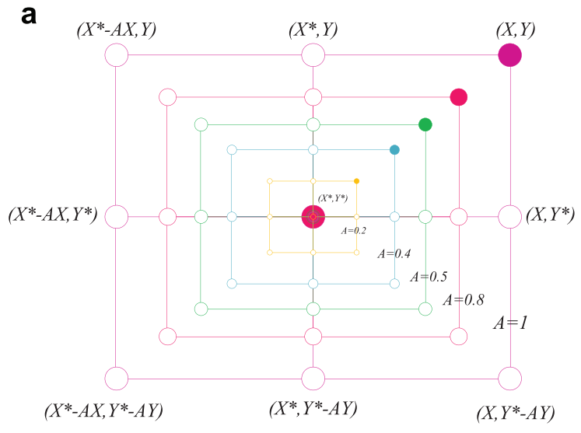
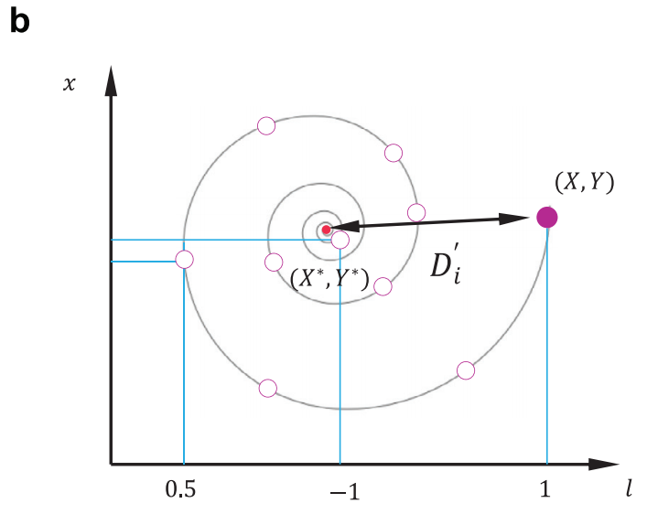
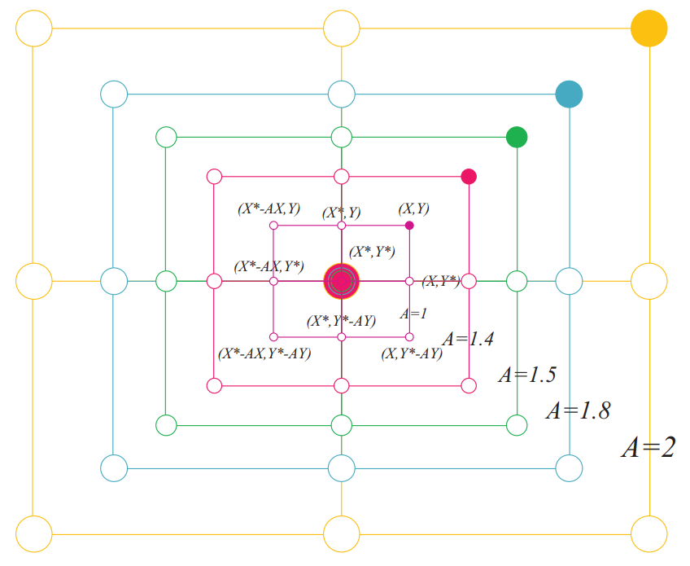
演算法流程
目前解
目前最佳解

Slide 4
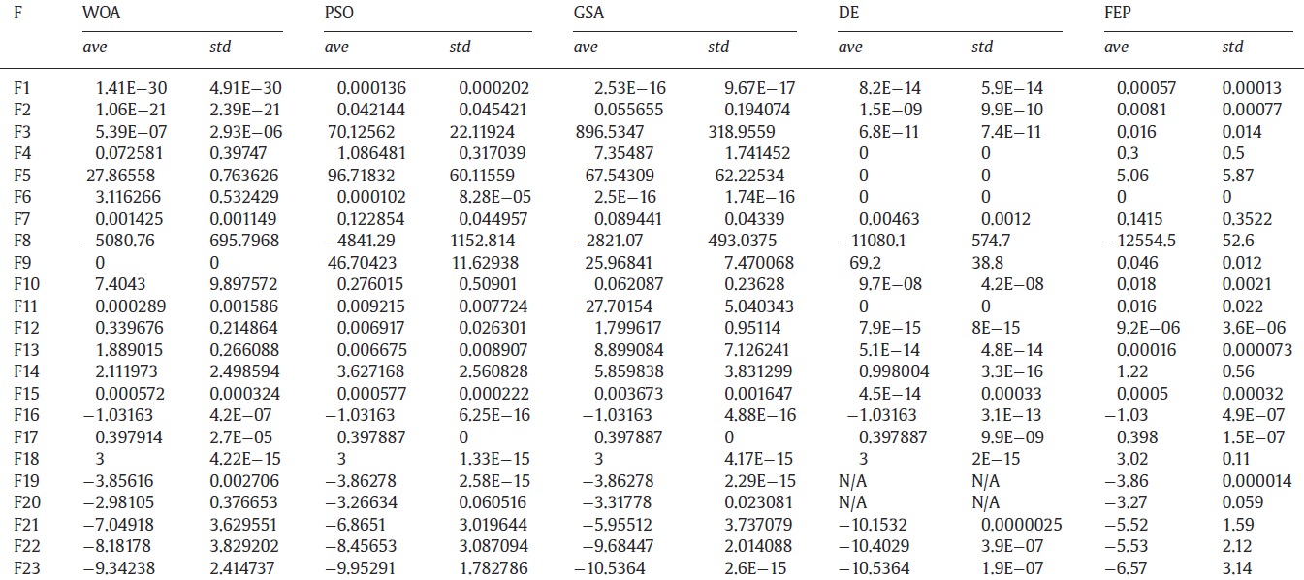
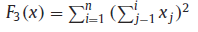
測試函數
DE : Differential evolution–a simple and efficient heuristic
FEP : Fast Evolutionary Programing
Notes:
1-7exploitation 8-23 exploration

Slide 5
測試標準
WOA
Iteration limit:500
Population size:30
PSO
Iteration limit:500
Population size:30
Cognition factor:0.5
Social factor:0.5
GA
Iteration limit:500
Population size:30
Crossover rate:0.8
Mutation rate:0.05
Deterministic
Crosstype:Convex
Number of cuts:1

Slide 6
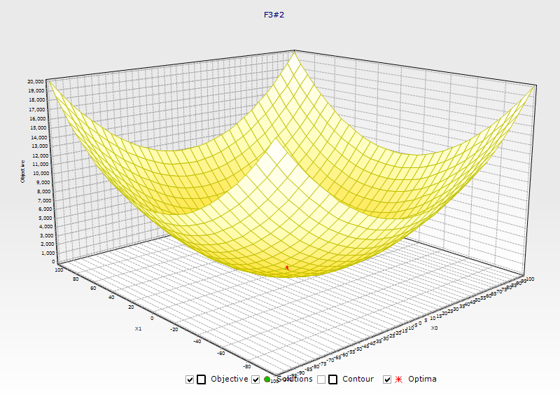
測試結果
F3 | WOA | PSO | GA
 | 25.4065 | 3295.683 | 14.7196
 | 2.6256 | 4338.339 | 27.0986
 | 9.0916 | 4085.543 | 21.5318
 | 2.7491 | 2162.682 | 21.1265
 | 9.6892 | 5578.252 | 12.2126
 | 0.0157 | 5163.906 | 15.1022
 | 2.3947 | 2152.884 | 6.6814
 | 40.5843 | 4902.807 | 24.5148
 | 31.592 | 2165.513 | 15.1916
 | 0.9134 | 3432.078 | 17.9497
平均 | 12.50621 | 3727.769 | 17.61288
標準差 | 13.87132 | 1225.268 | 5.784719
最佳 | 0.0157 | 2152.884 | 6.6814

Slide 7
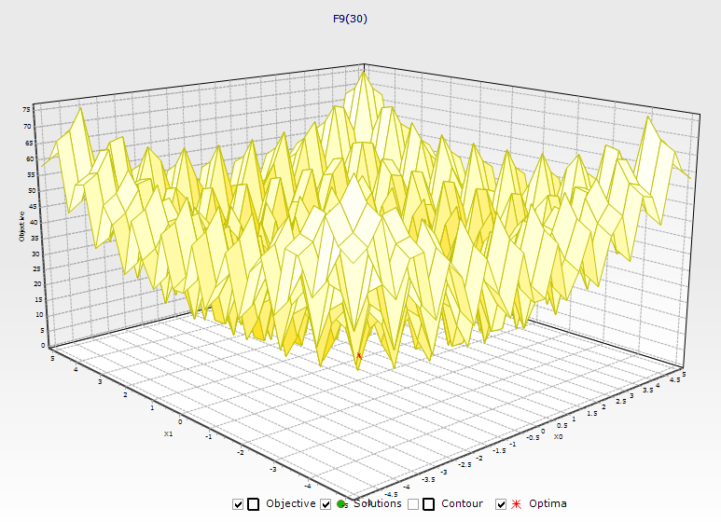
測試結果
F9 | WOA | PSO | GA
 | 24.5894 | 231.0028 | 11.1889
 | 73.8395 | 247.4228 | 10.2222
 | 76.9568 | 194.8283 | 10.7695
 | 53.041 | 222.0547 | 5.3252
 | 33.6493 | 256.6021 | 11.0713
 | 52.4602 | 221.5816 | 8.2619
 | 0.2725 | 179.4031 | 10.5523
 | 80.1452 | 22939302 | 8.6373
 | 45.7585 | 265.0534 | 8.2636
 | 0.0016 | 224.5838 | 9.9169
平均 | 44.0714 | 2294134 | 9.42091
標準差 | 27.87694 | 6881723 | 1.729391
最佳 | 0.0016 | 179.4031 | 5.3252

Slide 8
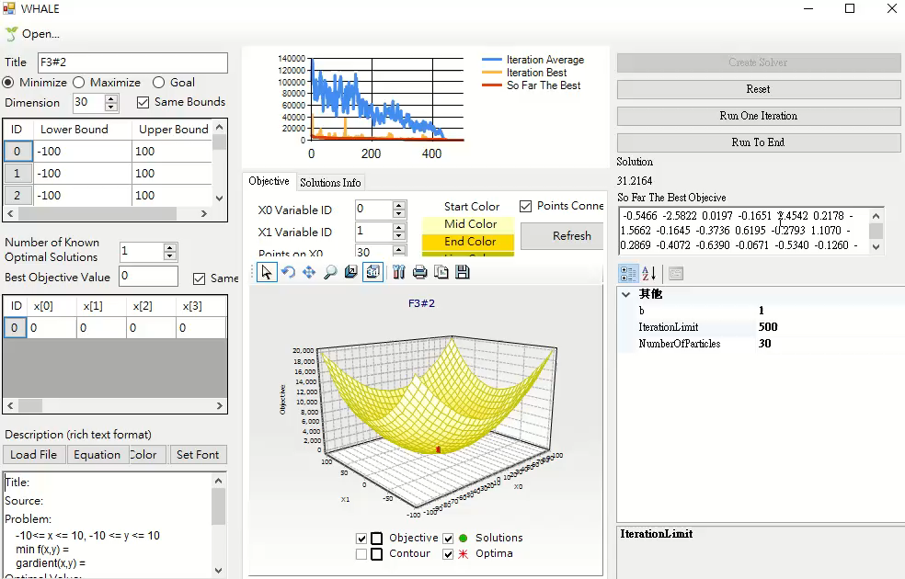
Demo

Slide 9
結論
Exploitation Capability : WOA優於PSO與GA
Exploration Capability : WOA優於PSO，與GA差不多

